Slide 1

DEPARTMENT OF
CSE (ARTIFICIAL INTELLIGENCE AND MACHINE LEARNING)
ACADEMIC YEAR 2025 - 2026
SEMESTER III
ARTIFICIAL INTELLIGENCE LABORATORY
MINI PROJECT REVIEW
Rock Paper Scissor AI
REGISTER NUMBER | 2117240030002
NAME | AJAY M
YEAR | II
SECTION | A
FACULTY IN-CHARGE | Mrs. M. Divya
10/28/2025
1

Slide 2
PROBLEM STATEMENT
Brief overview of Artificial Intelligence concepts:
Artificial Intelligence (AI) enables machines to simulate human intelligence through learning, reasoning, and decision-making. Using AI, systems can analyze patterns, make predictions, and adapt based on data.
Introduction of problem statement:
The classic game Rock, Paper, Scissors is a simple hand game with three possible moves. Traditionally, it relies on chance and human decision-making. By applying AI, we can develop a system that learns from player patterns, predicts their next move, and responds strategically. This project explores how machine learning can be used in real-time interactive gaming scenarios.
Clear and precise problem statement:
To design and implement an AI-based Rock, Paper, Scissors game that intelligently predicts the user’s next move using pattern recognition or probabilistic algorithms, thereby creating a challenging and adaptive gaming experience.
Outcome:
The expected outcome is an interactive AI system that competes effectively with the user by predicting and adapting to their playstyle. This project demonstrates how AI can learn from human behavior and can be extended to develop more advanced predictive systems in gaming and human-computer interaction.
10/28/2025
2

Slide 3
THEORETICAL BACKGROUND
Background of the Problem:
Rock, Paper, Scissors is a simple yet strategic game often used to study human behavior and randomness. In traditional play, each move has an equal probability of winning, losing, or drawing. However, humans tend to form patterns unconsciously, which AI can exploit using predictive algorithms.
Justification for Choosing the Algorithm:
For this project, a pattern recognition algorithm using frequency analysis or a simple Markov model is chosen. It is lightweight, fast, and suitable for real-time prediction in a simple interactive game environment.
Explanation of Algorithm (with Example):
The AI records the player’s previous moves and calculates the probability of the next move.
Example:
If the player often plays “Rock” after “Paper,” the AI predicts “Rock” next and chooses “Paper” to win. Over time, the model adapts based on updated player behavior data.
10/28/2025
3

Slide 4
IMPLEMENTATION AND CODE
Link to code in Git-hub Repository
List | Git-hub Repository Links
Implementation of Code Link | https://github.com/Ajay0000777/Ai-mini-project-.git
Word Document Report Link | https://github.com/Ajay0000777/Ai-mini-project-.git
PPT Link | https://github.com/Ajay0000777/Ai-mini-project-.git
10/28/2025
4

Slide 5
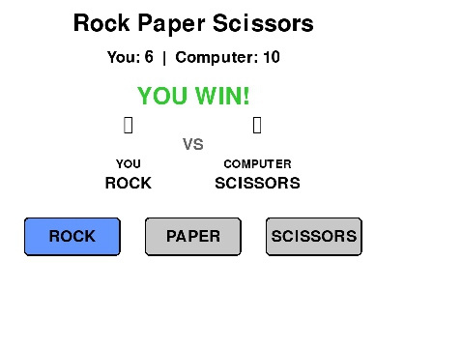
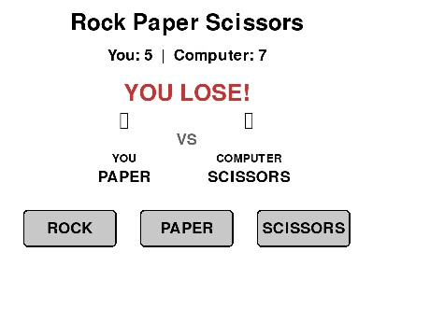
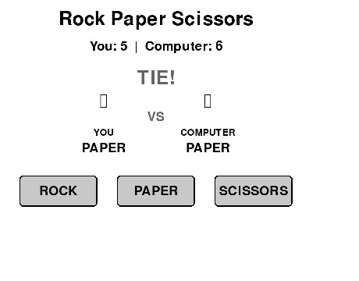
OUTPUT AND RESULTS
10/28/2025
5

Slide 6
REFERENCES
“Artificial Intelligence: A Modern Approach” – Stuart Russell & Peter Norvig, Pearson Education.
(For understanding AI fundamentals and decision-making models.)
Python Programming for Beginners – John Zelle, Franklin, Beedle & Associates.
(For Python basics and algorithm implementation.)
Pygame Documentation – https://www.pygame.org/docs/
(For understanding Pygame modules, event handling, and graphics rendering.)
“Pattern Recognition and Machine Learning” – Christopher M. Bishop, Springer.
(For insights into pattern recognition and prediction algorithms.)
Real Python Blog – “Building Games with Pygame”
https://realpython.com/pygame-a-primer/
(For practical guidance on developing interactive Python games.)
10/28/2025
6

